Slide 1
Latent Variable Models and Signal Separation
Class 12. 11 Oct 2011

Slide 2
Summary So Far
PLCA:
  The basic mixture-multinomial model for audio (and other data)
Sparse Decomposition:
  The notion of sparsity and how it can be imposed on learning
Sparse Overcomplete Decomposition:
  The notion of overcomplete basis set
Example-based representations
  Using the training data itself as our representation

Slide 3
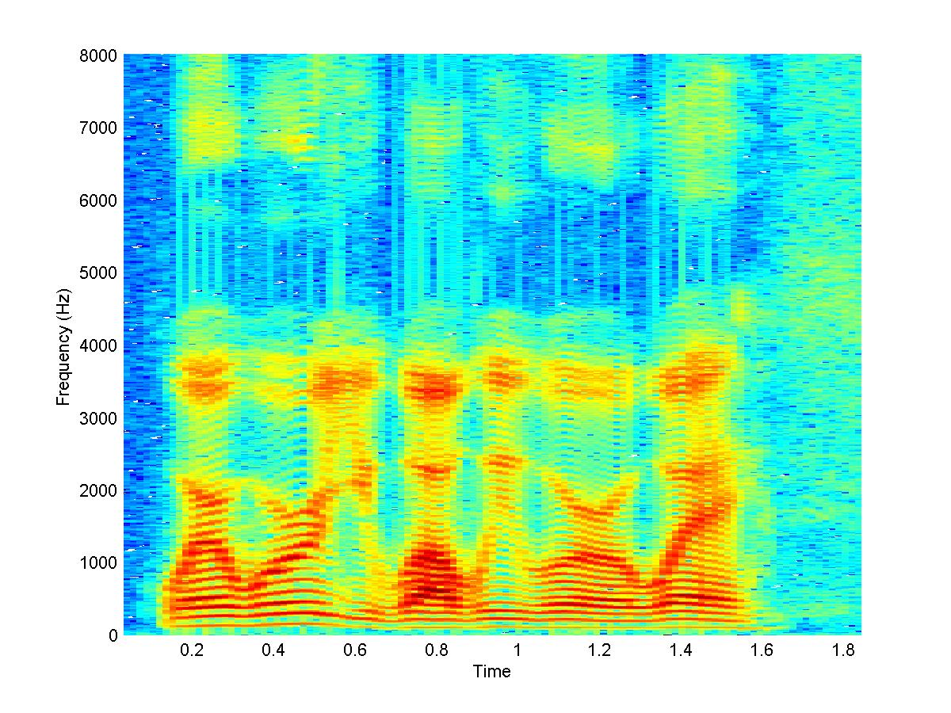

Next up: Shift/Transform Invariance
Sometimes the “typical” structures that compose a sound are wider than one spectral frame
  E.g. in the above example we note multiple examples of a pattern that spans several frames

Slide 4
Next up: Shift/Transform Invariance
Sometimes the “typical” structures that compose a sound are wider than one spectral frame
  E.g. in the above example we note multiple examples of a pattern that spans several frames
Multiframe patterns may also be local in frequency
  E.g. the two green patches are similar only in the region enclosed by the blue box

Slide 5
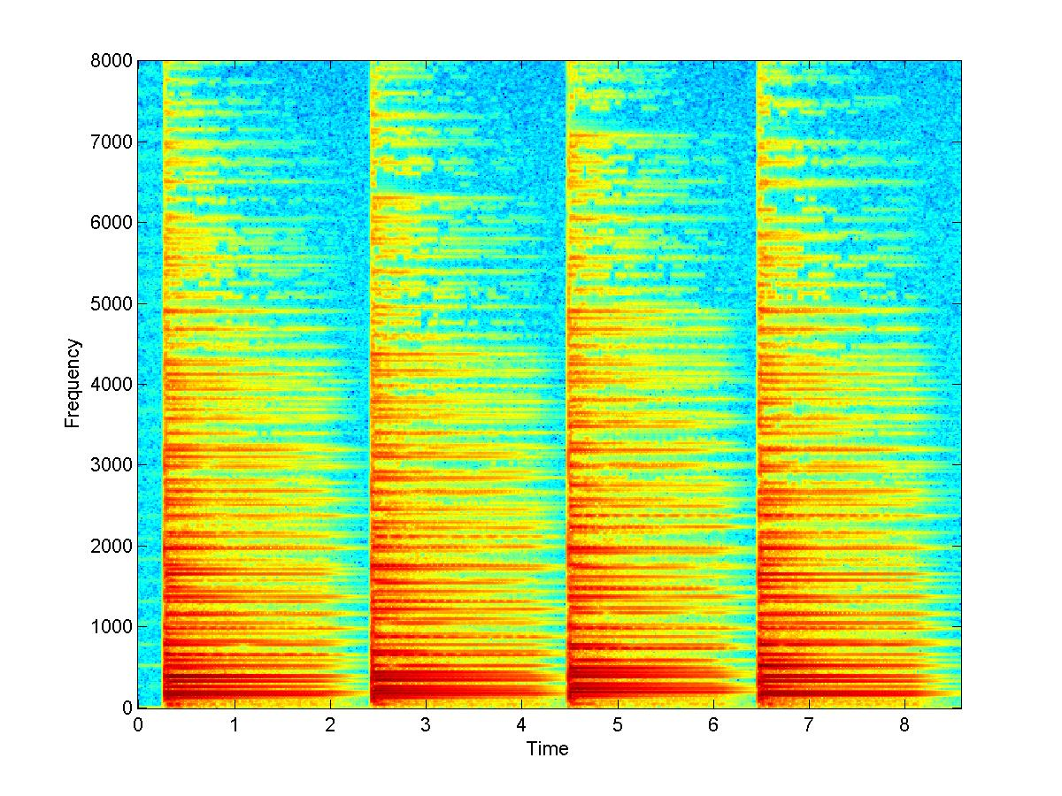
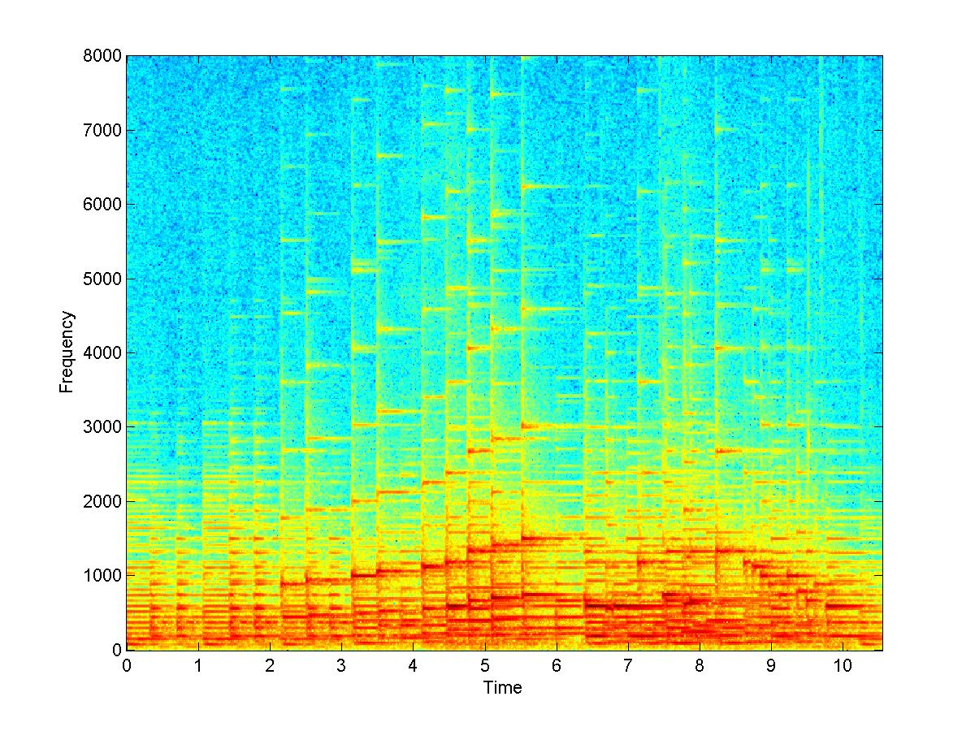
Patches are more representative than frames
Four bars from a music example
The spectral patterns are actually patches
  Not all frequencies fall off in time at the same rate
The basic unit is a spectral patch, not a spectrum

Slide 6
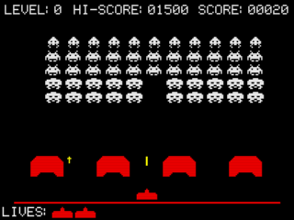
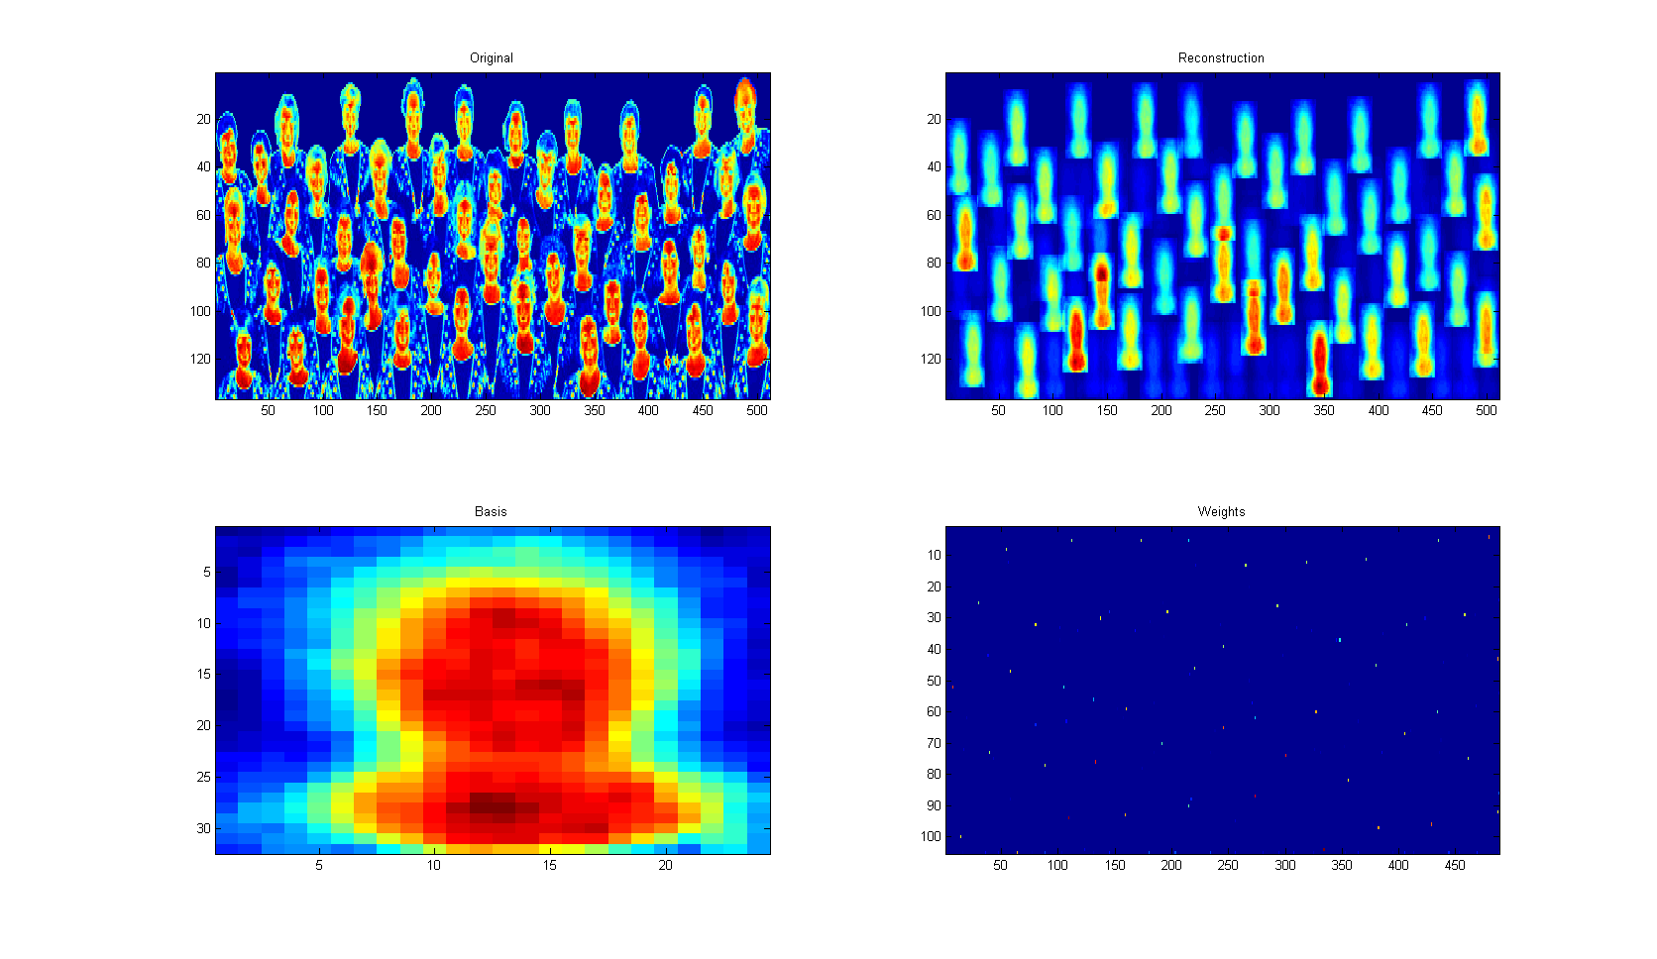
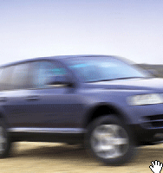
Images: Patches often form the image
A typical image component may be viewed as a patch
  The alien invaders
  Face like patches
  A car like patch
    overlaid on itself many times..

Slide 7
Shift-invariant modelling
A shift-invariant model permits individual bases to be patches
Each patch composes the entire image.
The data is a sum of the compositions from individual patches

Slide 8




Shift Invariance in one Dimension
5
15
5
5
98
444
1
2
74
453
99
1
7
520
453
37
91
411
501
502
515
8
164
81
81
147
224
327
1
224
147
201
38
1
111
127
24
27
101
203
399
6
369
47
7
37
69
477
Our bases are now “patches”
  Typical spectro-temporal structures
The urns now represent patches
  Each draw results in a (t,f) pair, rather than only f
  Also associated with each urn: A shift probability distribution P(T|z)
The overall drawing process is slightly more complex
Repeat the following process:
  Select an urn Z with a probability P(Z)
  Draw a value T from P(t|Z)
  Draw (t,f) pair from the urn
  Add to the histogram at (t+T, f)

Slide 9
Shift Invariance in one Dimension
5
15
5
5
98
444
1
2
74
453
99
1
7
520
453
37
91
411
501
502
515
8
164
81
81
147
224
327
1
224
147
201
38
1
111
127
24
27
101
203
399
6
369
47
7
37
69
477
The process is shift-invariant because the probability of drawing a shift P(T|Z) does not affect the probability of selecting urn Z
Every location in the spectrogram has contributions from every urn patch

Slide 10
Shift Invariance in one Dimension
5
15
5
5
98
444
1
2
74
453
99
1
7
520
453
37
91
411
501
502
515
8
164
81
81
147
224
327
1
224
147
201
38
1
111
127
24
27
101
203
399
6
369
47
7
37
69
477
The process is shift-invariant because the probability of drawing a shift P(T|Z) does not affect the probability of selecting urn Z
Every location in the spectrogram has contributions from every urn patch

Slide 11
Shift Invariance in one Dimension
5
15
5
5
98
444
1
2
74
453
99
1
7
520
453
37
91
411
501
502
515
8
164
81
81
147
224
327
1
224
147
201
38
1
111
127
24
27
101
203
399
6
369
47
7
37
69
477
The process is shift-invariant because the probability of drawing a shift P(T|Z) does not affect the probability of selecting urn Z
Every location in the spectrogram has contributions from every urn patch

Slide 12
Probability of drawing a particular (t,f) combination
The parameters of the model:
  P(t,f|z) – the urns
  P(T|z) – the urn-specific shift distribution
  P(z) – probability of selecting an urn
The ways in which (t,f) can be drawn:
  Select any urn z
  Draw T from the urn-specific shift distribution
  Draw (t-T,f) from the urn
The actual probability sums this over all shifts and urns

Slide 13
Learning the Model
The parameters of the model are learned analogously to the manner in which mixture multinomials are learned
Given observation of (t,f), it we knew which urn it came from and the shift, we could compute all probabilities by counting!
  If shift is T and urn is Z
    Count(Z) = Count(Z) + 1
    For shift probability: Count(T|Z) = Count(T|Z)+1
    For urn: Count(t-T,f | Z) = Count(t-T,f|Z) + 1
      Since the value drawn from the urn was t-T,f
  After all observations are counted:
    Normalize Count(Z) to get P(Z)
    Normalize Count(T|Z) to get P(T|Z)
    Normalize Count(t,f|Z) to get P(t,f|Z)
Problem: When learning the urns and shift distributions from a histogram, the urn (Z) and shift (T) for any draw of (t,f) is not known
  These are unseen variables

Slide 14
Learning the Model
Urn Z and shift T are unknown
  So (t,f) contributes partial counts to every value of T and Z
  Contributions are proportional to the a posteriori probability of Z and T,Z
Each observation of (t,f)
  P(z|t,f) to the count of the total number of draws from the urn
    Count(Z) = Count(Z) + P(z | t,f)
  P(z|t,f)P(T | z,t,f) to the count of the shift T for the shift distribution
    Count(T | Z) = Count(T | Z) + P(z|t,f)P(T | Z, t, f)
  P(z|t,f)P(T | z,t,f) to the count of (t-T, f) for the urn
    Count(t-T,f | Z) = Count(t-T,f | Z) + P(z|t,f)P(T | z,t,f)

Slide 15
Shift invariant model: Update Rules
Given data (spectrogram) S(t,f)
Initialize P(Z), P(T|Z), P(t,f | Z)
Iterate

Slide 16

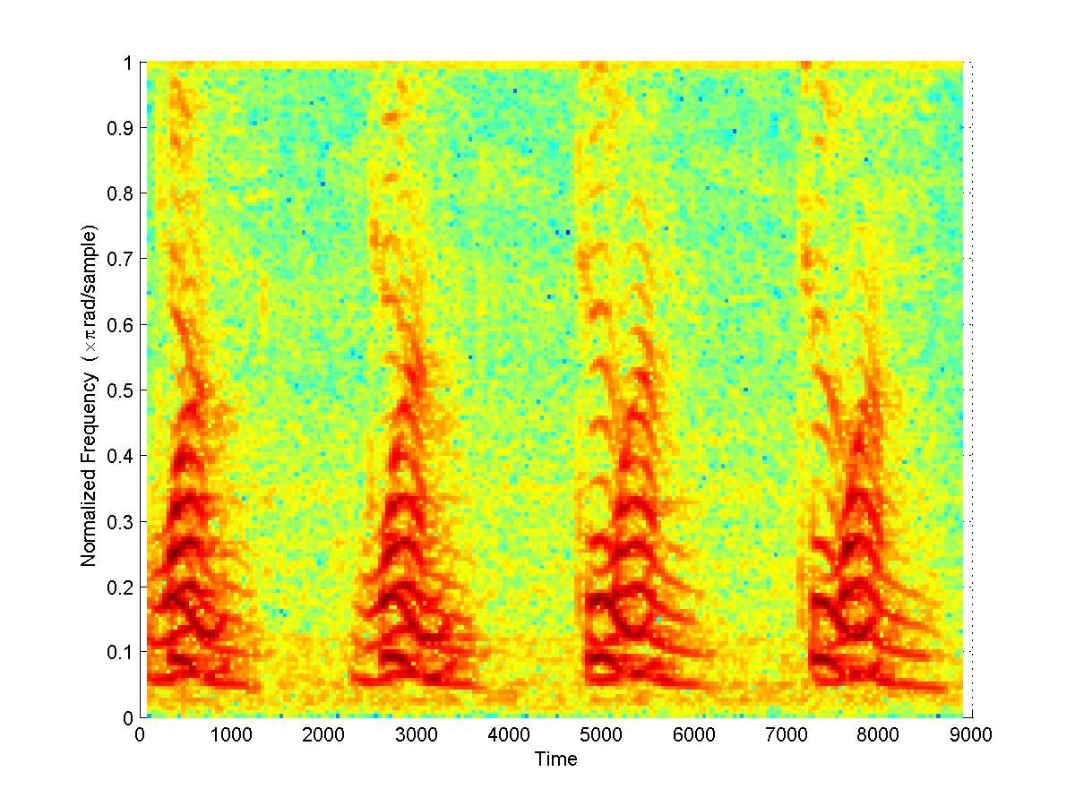
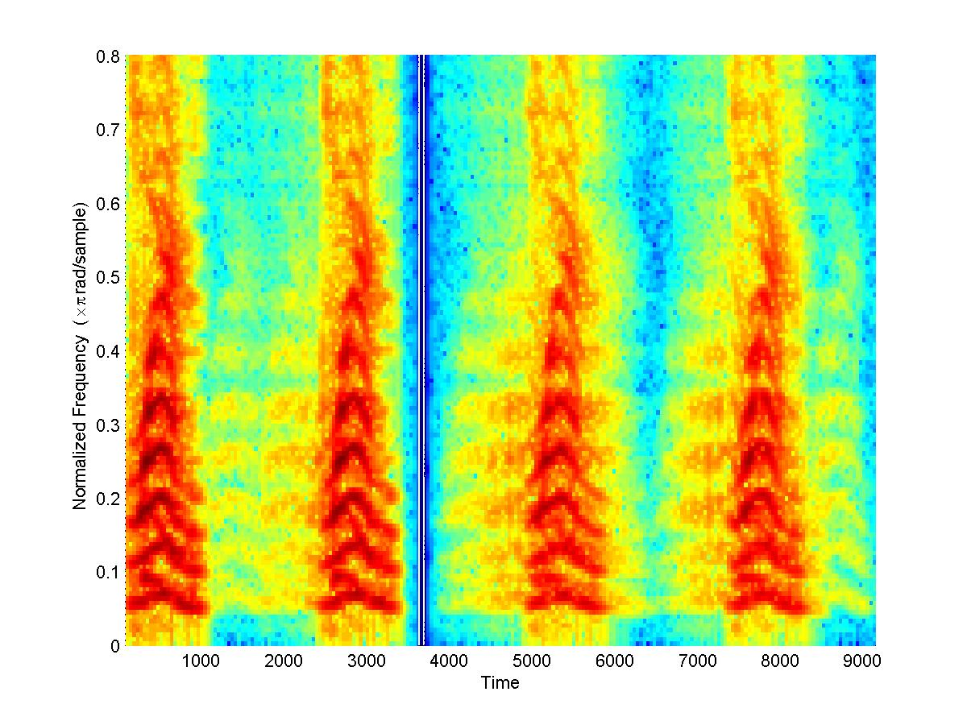
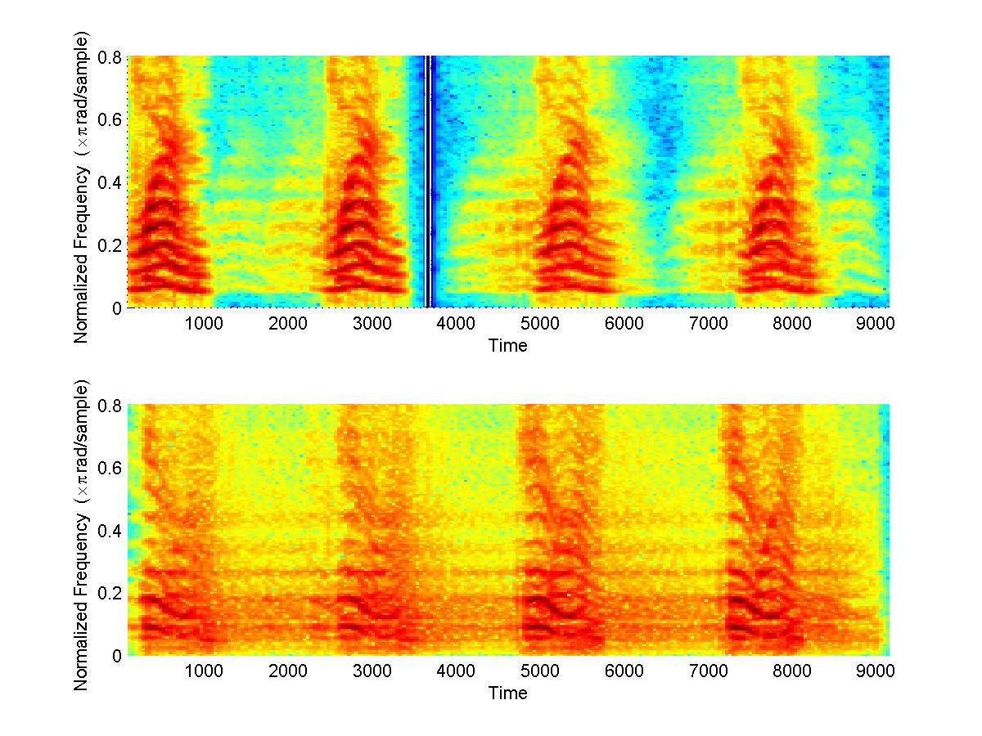
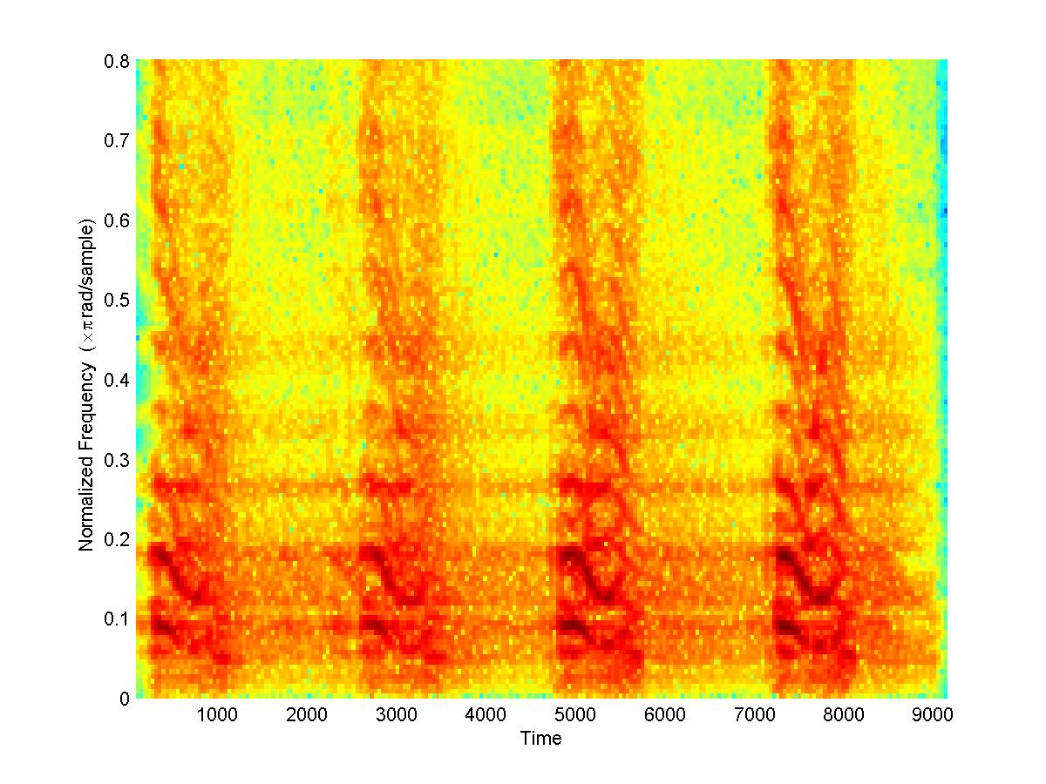

Shift-invariance in one time: example
An Example: Two distinct sounds occuring with different repetition rates within a signal
  Modelled as being composed from two time-frequency bases
  NOTE: Width of patches must be specified
INPUT SPECTROGRAM
Discovered time-frequency
“patch” bases (urns)
Contribution of individual bases to the recording

Slide 17
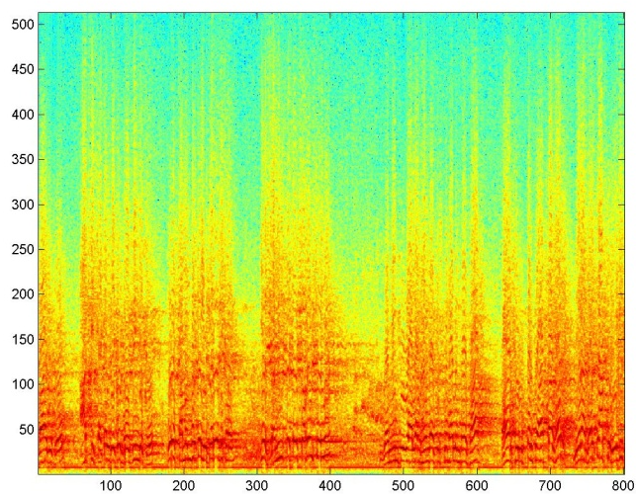

Shift Invariance in Time: Dereverberation
+
=
Reverberation – a simple model
  The Spectrogram of the reverberated signal is a sum of the spectrogram of the clean signal and several shifted and scaled versions of itself
  A convolution of the spectrogram and a room response

Slide 18
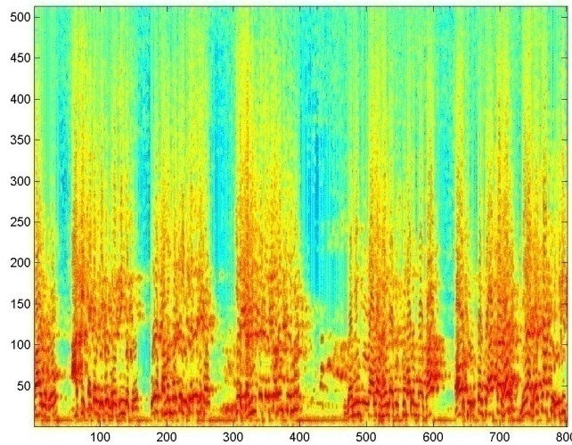
Dereverberation
Given the spectrogram of the reverberated signal:
  Learn a shift-invariant model with a single patch basis
    Sparsity must be enforced on the basis
  The “basis” represents the clean speech!

Slide 19
Shift Invariance in Two Dimensions
5
15
5
5
98
444
1
2
74
453
99
1
7
520
453
37
91
411
501
502
515
8
164
81
81
147
224
327
1
224
147
201
38
1
111
127
24
27
101
203
399
6
369
47
7
37
69
477
We now have urn-specific shifts along both T and F
The Drawing Process
  Select an urn Z with a probability P(Z)
  Draw SHIFT values (T,F) from P_{s}(T,F|Z)
  Draw (t,f) pair from the urn
  Add to the histogram at (t+T, f+F)
This is a two-dimensional shift-invariant model
  We have shifts in both time and frequency
    Or, more generically, along both axes

Slide 20
Learning the Model
Learning is analogous to the 1-D case
Given observation of (t,f), it we knew which urn it came from and the shift, we could compute all probabilities by counting!
  If shift is T,F and urn is Z
    Count(Z) = Count(Z) + 1
    For shift probability: ShiftCount(T,F|Z) = ShiftCount(T,F|Z)+1
    For urn: Count(t-T,f-F | Z) = Count(t-T,f-F|Z) + 1
      Since the value drawn from the urn was t-T,f-F
  After all observations are counted:
    Normalize Count(Z) to get P(Z)
    Normalize ShiftCount(T,F|Z) to get P_{s}(T,F|Z)
    Normalize Count(t,f|Z) to get P(t,f|Z)
Problem: Shift and Urn are unknown

Slide 21
Learning the Model
Urn Z and shift T,F are unknown
  So (t,f) contributes partial counts to every value of T,F and Z
  Contributions are proportional to the a posteriori probability of Z and T,F|Z
Each observation of (t,f)
  P(z|t,f) to the count of the total number of draws from the urn
    Count(Z) = Count(Z) + P(z | t,f)
  P(z|t,f)P(T,F | z,t,f) to the count of the shift T,F for the shift distribution
    ShiftCount(T,F | Z) = ShiftCount(T,F | Z) + P(z|t,f)P(T | Z, t, f)
  P(T | z,t,f) to the count of (t-T, f-F) for the urn
    Count(t-T,f-F | Z) = Count(t-T,f-F | Z) + P(z|t,f)P(t-T,f-F | z,t,f)

Slide 22
Shift invariant model: Update Rules
Given data (spectrogram) S(t,f)
Initialize P(Z), P_{s}(T,F|Z), P(t,f | Z)
Iterate

Slide 23
2D Shift Invariance: The problem of indeterminacy
P(t,f|Z) and P_{s}(T,F|Z) are analogous
  Difficult to specify which will be the “urn” and which the “shift”
Additional constraints required to ensure that one of them is clearly the shift and the other the urn
Typical solution: Enforce sparsity on P_{s}(T,F|Z)
  The patch represented by the urn occurs only in a few locations in the data

Slide 24
Example: 2-D shift invariance
Only one “patch” used to model the image (i.e. a single urn)
  The learnt urn is an “average” face, the learned shifts show the locations of faces

Slide 25
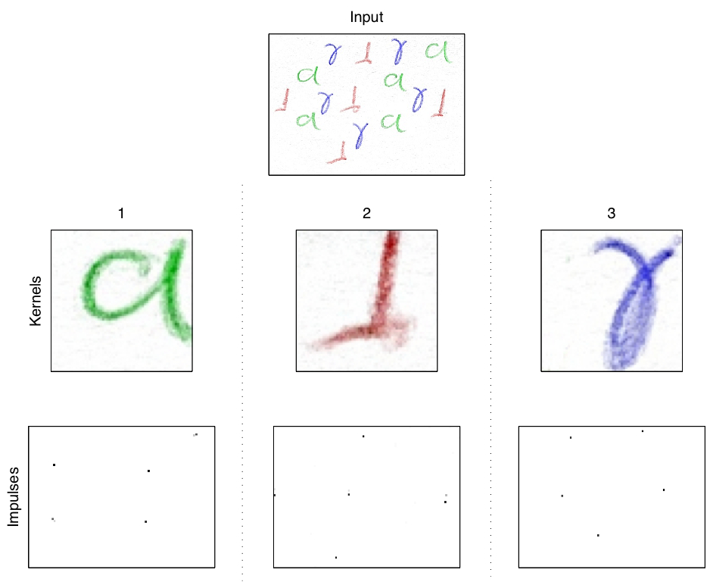
Example: 2-D shift invarince
The original figure has multiple handwritten renderings of three characters
  In different colours
The algorithm learns the three characters and identifies their locations in the figure
Input data
Discovered
Patches
Patch
Locations

Slide 26


Beyond shift-invariance: transform invariance
5
15
5
5
98
444
1
2
74
453
99
1
7
520
453
37
91
411
501
502
515
8
164
81
81
147
224
327
1
224
147
201
38
1
111
127
24
27
101
203
399
6
369
47
7
37
69
477
The draws from the urns may not only be shifted, but also transformed
The arithmetic remains very similar to the shift-invariant model
  We must now impose one of an enumerated set of transforms to (t,f), after shifting them by (T,F)
  In the estimation, the precise transform applied is an unseen variable

Slide 27
Transform invariance: Generation
The set of transforms is enumerable
  E.g. scaling by 0.9, scaling by 1.1, rotation right by 90degrees, rotation left by 90 degrees, rotation by 180 degrees, reflection
  Transformations can be chosen by draws from a distribution over transforms
    E.g. P(rotation by 90 degrees) = 0.2..
    Distributions are URN SPECIFIC
The drawing process:
  Select an urn Z (patch)
  Select a shift (T,F) from P_{s}(T, F| Z)
  Select a transform from P(txfm | Z)
  Select a (t,f) pair from P(t,f | Z)
  Transform (t,f) to txfm(t,f)
  Increment the histogram at txfm(t,f) + (T,F)

Slide 28
Transform invariance
The learning algorithm must now estimate
  P(Z) – probability of selecting urn/patch in any draw
  P(t,f|Z) – the urns / patches
  P(txfm | Z) – the urn specific distribution over transforms
  P_{s}(T,F|Z) – the urn-specific shift distribution
Essentially determines what the basic shapes are, where they occur in the data and how they are transformed
The mathematics for learning are similar to the maths for shift invariance
  With the addition that each instance of a draw must be fractured into urns, shifts AND transforms
Details of learning are left as an exercise
  Alternately, refer to Madhusudana Shashanka’s PhD thesis at BU

Slide 29
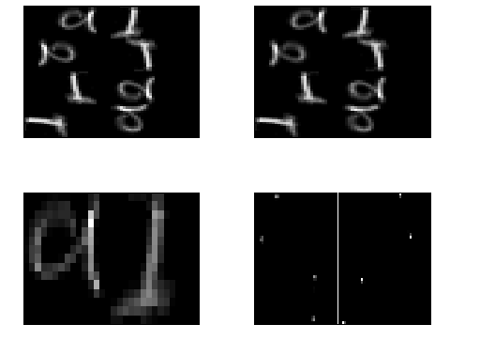
Example: Transform Invariance
Top left: Original figure
Bottom left – the two bases discovered
Bottom right –
  Left panel, positions of “a”
  Right panel, positions of “l”
Top right: estimated distribution underlying original figure

Slide 30
Transform invariance: model limitations and extensions
The current model only allows one transform to be applied at any draw
  E.g. a basis may be rotated or scaled, but not scaled and rotated
An obvious extension is to permit combinations of transformations
  Model must be extended to draw the combination from some distribution
Data dimensionality: All examples so far assume only two dimensions (e.g. in spectrogram or image)
The models are trivially extended to higher-dimensional data

Slide 31
Transform Invariance: Uses and Limitations
Not very useful to analyze audio
May be used to analyze images and video
Main restriction: Computational complexity
  Requires unreasonable amounts of memory and CPU
  Efficient implementation an open issue

Slide 32
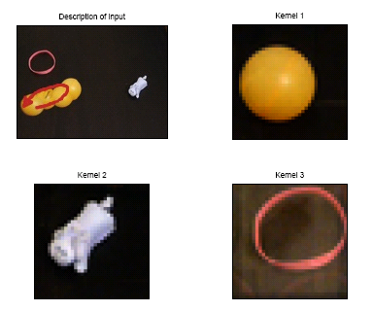
Example: Higher dimensional data
Video example

